Slide 1
Indus Valley Civilization

Slide 2
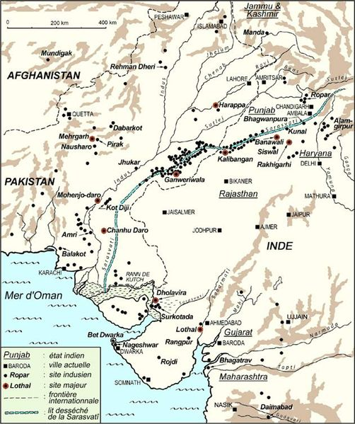
Geography
The Indus Valley Civilisation or Harappan Civilisation was a Bronze Age civilisation mainly in the northwestern regions of South Asia, extending from what today is northeast Afghanistan to Pakistan and northwest India.
Indus Valley settlements could be 8,000 years old

Slide 3
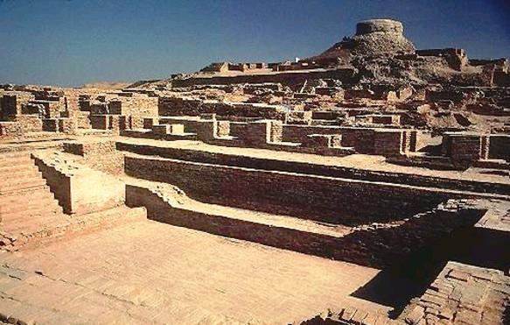
Two Main Cities
Mohenjo-daro
Harappa
The Indus Valley was home to one of the world's first large civilisations. It began nearly 5,000 years ago in an area of modern-day Pakistan and Northern India. There were more than 1,400 towns and cities in the Indus Valley. The biggest were Harappa and Mohenjo-Daro

Slide 4
Main River
The Indus Valley Civilization was an ancient civilization located in what is Pakistan and northwest India today, on the fertile flood plain of the Indus River and its vicinity. Evidence of religious practices in this area date back approximately to 5500 BCE.
A river keeps the land green and fertile for growing crops. Farmers lived together in villages. Indus Valley cities like Harappa and Mohenjo-Daro began as riverside farming villages about 5,000 years ago. The Indus people needed river water to drink, wash and to irrigate their fields.

Slide 5
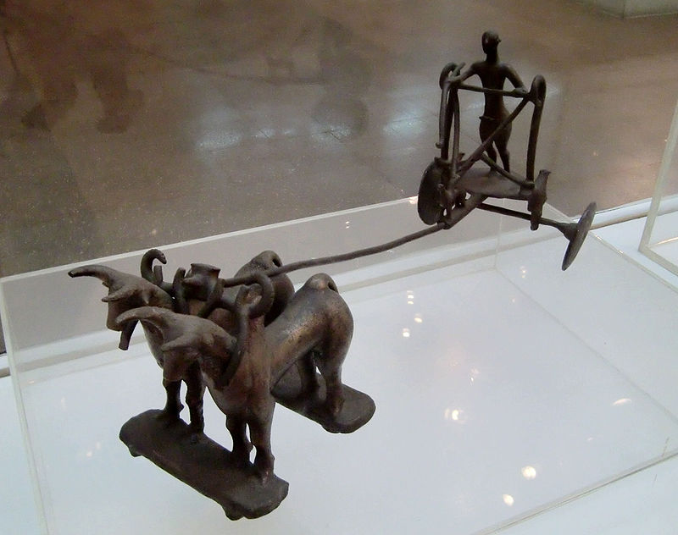
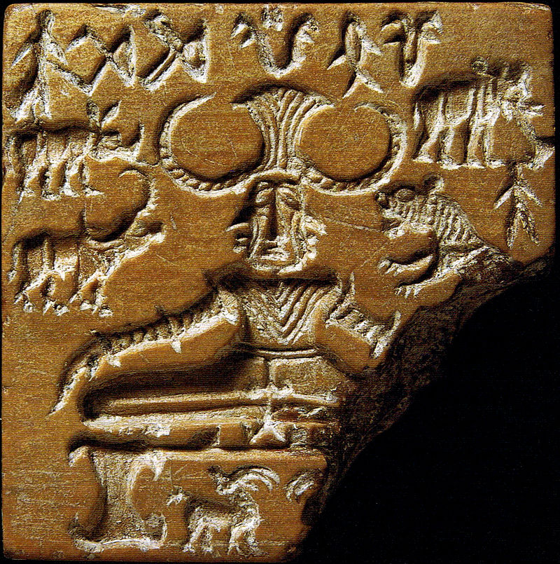
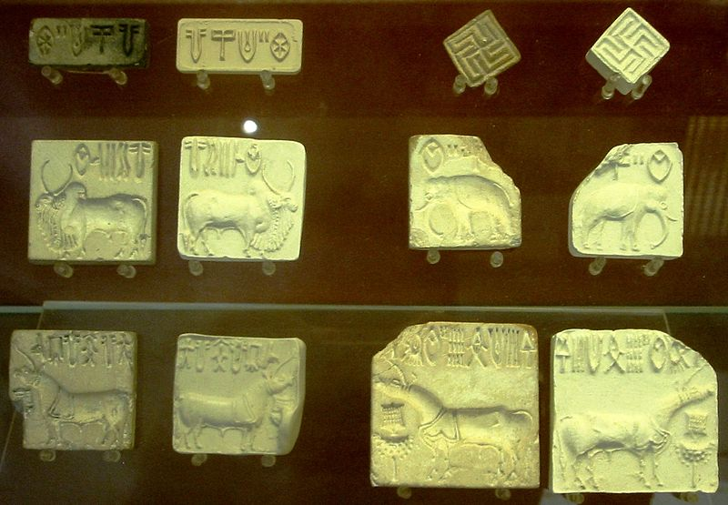
Relics

Slide 6
Decline of Indus Valley Civilization
The decline of the culture was not similar in all the sites nor was it uniform. According to some historians, Mohenjodaro had started declining by 2200 B.C and came to an end by 2000 B.C . Mohenjodaro along with another site named Dholavira show signs of gradual decline. Natural disasters did play a significant role in the decline though not a sudden one but rather a repeated flooding / drought. Harappan civilization was a highly developed and complex society with large scale farming activities taking place. This may have a led to a gradual decline in the soil fertility which in turn could have led to a crisis of food supply. It is also important to note that though Harappan civilization was urban civilization it still needed the labour from villages to work the fields. This can be seen from the fortification around the exacavations. Layers of silt found in Mohenjodaro point to repeated inundation of the land which may also have to crop failure.

